Slide 1
Cash Flow Hard to Earn, Easy to Burn
AREC 213
Week 7
Fall 2014

Slide 2
The Importance of Cash
Cash is KING

Slide 3

The Importance of Cash
Life
Business

Slide 4
The Importance of Cash
It is GOOD CASH FLOW that maintains the Crown and keeps the KING or QUEEN in this case, in power.

Slide 5
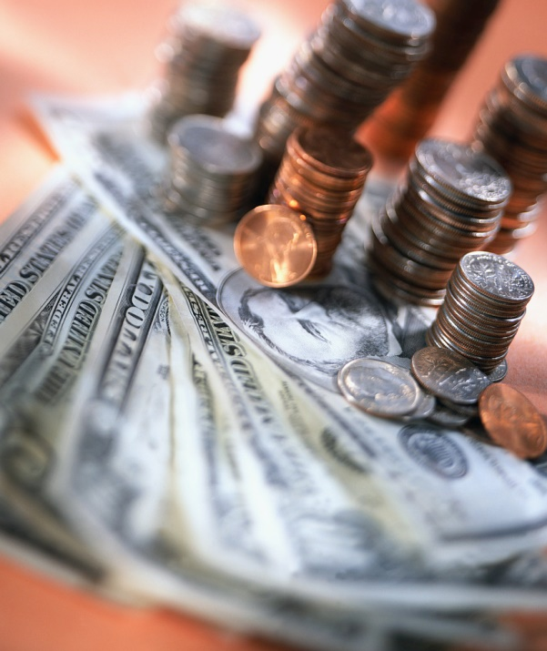
Terms to Know
What is CASH?

Slide 6
Terms to Know
Cash – Money on-hand, ready to use in your business.
Money in the bank
Checks received
Bank cards processed
Marketable securities, sometimes referred to as cash equivalents.

Slide 7
Terms to Know
Cash Flow

Slide 8
Terms to Know
Cash Flow –
Movement of cash into and out of a business
Payments to employees and suppliers
Collections from customers or cash sales

Slide 9

Yes, Cash Flow can be Global, Even for a Small Business

Slide 10
Terms to Know
Cash Position –
The AMOUNT of cash and liquid investments a company has in the bank AT ANY GIVEN POINT IN TIME.

Slide 11
Terms to Know
Cash Inflow –
Positive Stream of CASH comes from
Operations
Financing
Investing

Slide 12
Terms to Know
Cash Outflow –
Negative stream of cash comes from
Operations
Financing
Investing

Slide 13
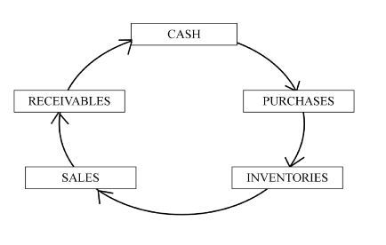
Terms to Know
Cash Cycle –
Time it takes to put cash to use and convert back to cash.

Slide 14
Terms to Know
Initial Investment –
Amount of money being spent to start your business. Usually a negative number.

Slide 15
Terms to Know
Burn Rate –
The amount of cash which is consumed by a business operating at a loss (start up operations).

Slide 16
Terms to Know
LIQUIDITY –
The ability of a company to repay its short term debts and obligations (usually less than one year) – ON-TIME

Slide 17
Terms to Know
Break-even –
Level of sales, in dollars, units or hours necessary to produce a “ZERO” profit, FROM OPERATIONS

Slide 18
The Importance of Cash
Life
Business

Slide 19
Cash Flow Example in LIFE
Assumptions:
You finish college and go to work in a NURSERY, starting salary $2000 per month, beginning January 1st. You live at home, mom and dad pay all the bills and even loan you their extra car to use. LIFE is GOOD.
January 31st you have a terrible fight with your parents and move out February 1st.

Slide 20
Cash Flow Example in LIFE
Now What???????
It’s February 1st and your loaded, you have direct deposit into your account. You have $2000 to spend, CORRECT?. CASH INFLOW
Nope!!!!! Your uncle SAM took his share first, a WOPPING $600. CASH OUTFLOW
What is your cash position as of the morning of February 1st

Slide 21
Cash Flow Example in LIFE
Your boss understands the mess and lets you have the day off – with pay.
You go out and rent an apt. for $800 per month.
Utilities will be only $50.00 per month.
The lease terms are a 10% late fee on the 6th.
You need transportation so you lease a car for $200 per month along with insurance for $45 per month and gas for $100 per month; $50 on the 1st and $50 on the 16th. Late pmts. $20 after 5 days late.

Slide 22
Cash Flow Example in LIFE
That night on the way home you remember you really need to eat this month so you go shopping and spend $200, which will last the entire month of February.
You get home EXHAUSTED and look for that glass of wine and low and behold you did not buy wine because you were not sure you could afford it.

Slide 23
Cash Flow Example in LIFE
QUESTIONS
What was your cash position at the start of the day?
What was your cash inflow for February?
What was your cash outflow for February?
What is your cash position at the end of the day?

Slide 24
Cash Flow in LIFE
Cash Inflow | Morn. 2/1 | Even. 2/1 | 2/16/2013 | 2/28/2013
Work | 2000 | 0 | 0 | 0
Total Inflow | 2000 | 0 | 0 | 0
Cash Outflow
Taxes | 600
Rent |  | 800
Utilities |  | 50
Car Lease |  | 200
Auto Ins. |  | 45
Auto Fuel |  | 50 | 50
Food |  | 200
Total Outflow | 600 | 1345 | 50 | 0
Cash Pos. | 1400 | 55 | 5 | 5

Slide 25
Cash Flow in LIFE
Cash Inflow | Morn. 3/1 | 3/10 | 3/21/2013 | 3/31/2013
Work | 0 | 0 | 2000 | 0
Borrow Cash | 0 | 2000 | 0 | 0
Cash Outflow
Taxes | 0 | 0 | 600 | 0
Rent | 800 | 880 | 0 | 0
Utilities | 50 | 50 | 0 | 0
Car Lease | 200 | 220 | 0 | 0
Auto Ins. | 45 | 45 | 0 | 0
Auto Fuel | 50 | 50 | 0 | 50
Food |  | 100 | 50 | 50
Total Outflow | 1145 | 1345 | 650 | 100
Start Cash | 5 | 5 | 660 | 2010
Cash Pos. | -1140 | 660 | 2010 | 1910

Slide 26
Cash Flow in LIFE
Cash Inflow | 4/7/2013 | 4/15/2013 | 4/21/2013 | 4/30/2013
Work | 2000 | 0 | 0 | 0
Borrow Cash | 0 | 0 | 0 | 0
Cash Outflow
Taxes | 500 | 0 | 0 | 0
Rent & Util. | 850 | 0 | 0 | 0
Prin. & Int. | 0 | 15 | 1800 | 207
Car Lease | 200 | 0 | 0 | 0
Auto Ins. | 45 | 0 | 0 | 0
Auto Fuel | 50 | 0 | 30 | 0
Food | 45 | 45 | 45 | 35
Total Outflow | 1690 | 60 | 1875 | 242
Start Cash | 1910 | 2220 | 2160 | 285
Cash Pos. | 2220 | 2160 | 285 | 43

Slide 27
Cash Flow in LIFE
So what is the BIG LESSON HERE or the BIG LESSON IN LIFE??????

Slide 28
TheBIG lesson in Life
Cash is KING

Slide 29
Cash Flow for Business
So what do you think the lesson for cash in business is???

Slide 30
TheBIG lesson in both Life and Business is the SAME
Cash is KING

